Slide 1
User Analysis:
CTR Prediction on Features & Behaviors
Yingfan Duan, Hazel Gu, Haotian Wu, Han Yu, Dawei Zhao

Slide 2
Agenda
01
Business Problem
04
Model Findings & Tests
Value & Impact
Model Evaluation
Feature Importance
02
Data
05
Discussion
EDA & Preprocessing
Feature Engineering
Key Takeaways
03
Model Mining
06
Future Works
LightGBM
Random Forest
Potential Improvements

Slide 3
01
Business Problem

Slide 4




Business Problem
Advertiser
Attempt to figure out the recipe for high CTR observations for Precision Marketing
Which 💗guy ad would you choose?
Project Objective
Predict 7th day’s Click-Through Rate based on prior consecutive 6 days
Notes:
动画
The core problems display advertising strives to solve is to deliver the right ads to the right people.

Slide 5



Business Value
Precision Marketing
Monetization
User Profile
User Behavior
Impression
Device Network
Apps
CTR
Click
Conversion Rate
Media Platform
Ads
Profile
Conversion
Notes:
Website monetization: The primary revenue source of social media company like Weibo’s was is from Internet traffic, and measured by eCPM( effective cost per mille).

Slide 6
02
Data & EDA

Slide 7
Dataset Introduction
Size & Shape
Size | 456 MB
Rows & Columns | #3M #36
Target Variable | ‘Label’ (1 = clicked)
Features Groups
User | uid age gender net_type …
Ads | adv_id slot_id Inter_type_cd …
Apps | spread_app_id app_first_class his_app_size …
Stats
Dtype | All numerical Int64 / float64
Missing | Represented by -1
Unique | uid: #1.05M adv_id: #5796

Slide 8
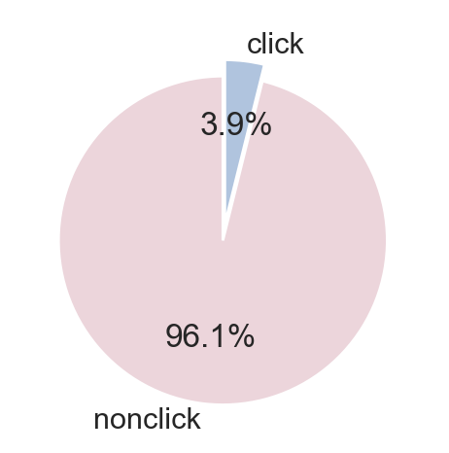
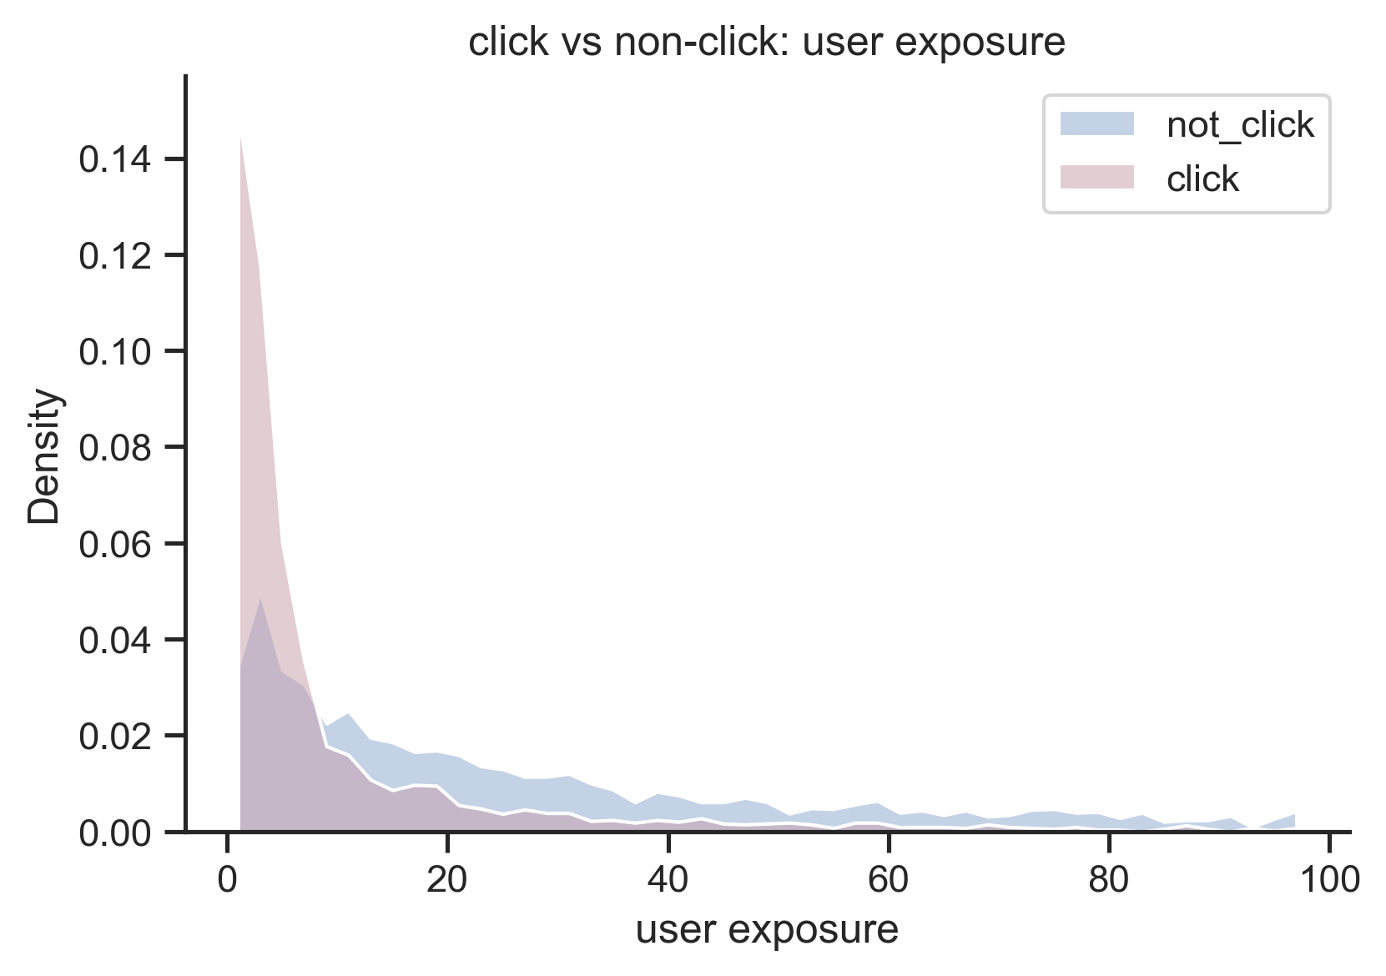
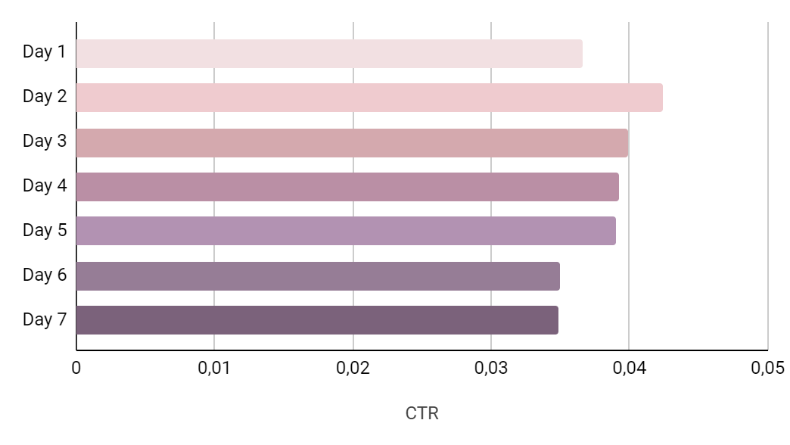
EDA
01
Pie Chart
03
Histplot
Very Imbalanced target variable
User with low impression are much more likely to click
02
Bar chart
CTR of Day 6 & 7 are lower,
Day 2 has the highest CTR

Slide 9
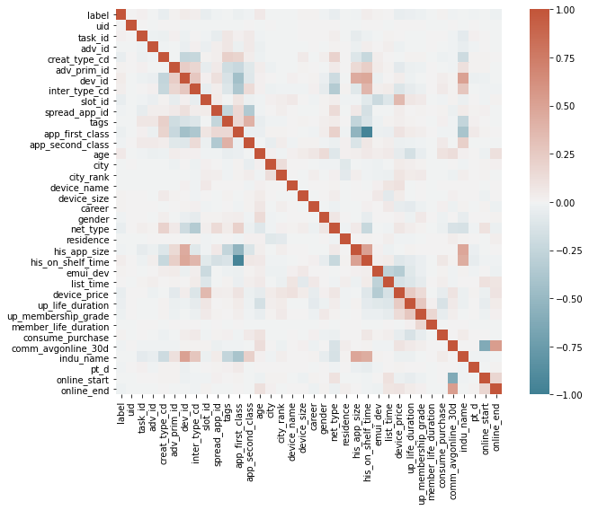
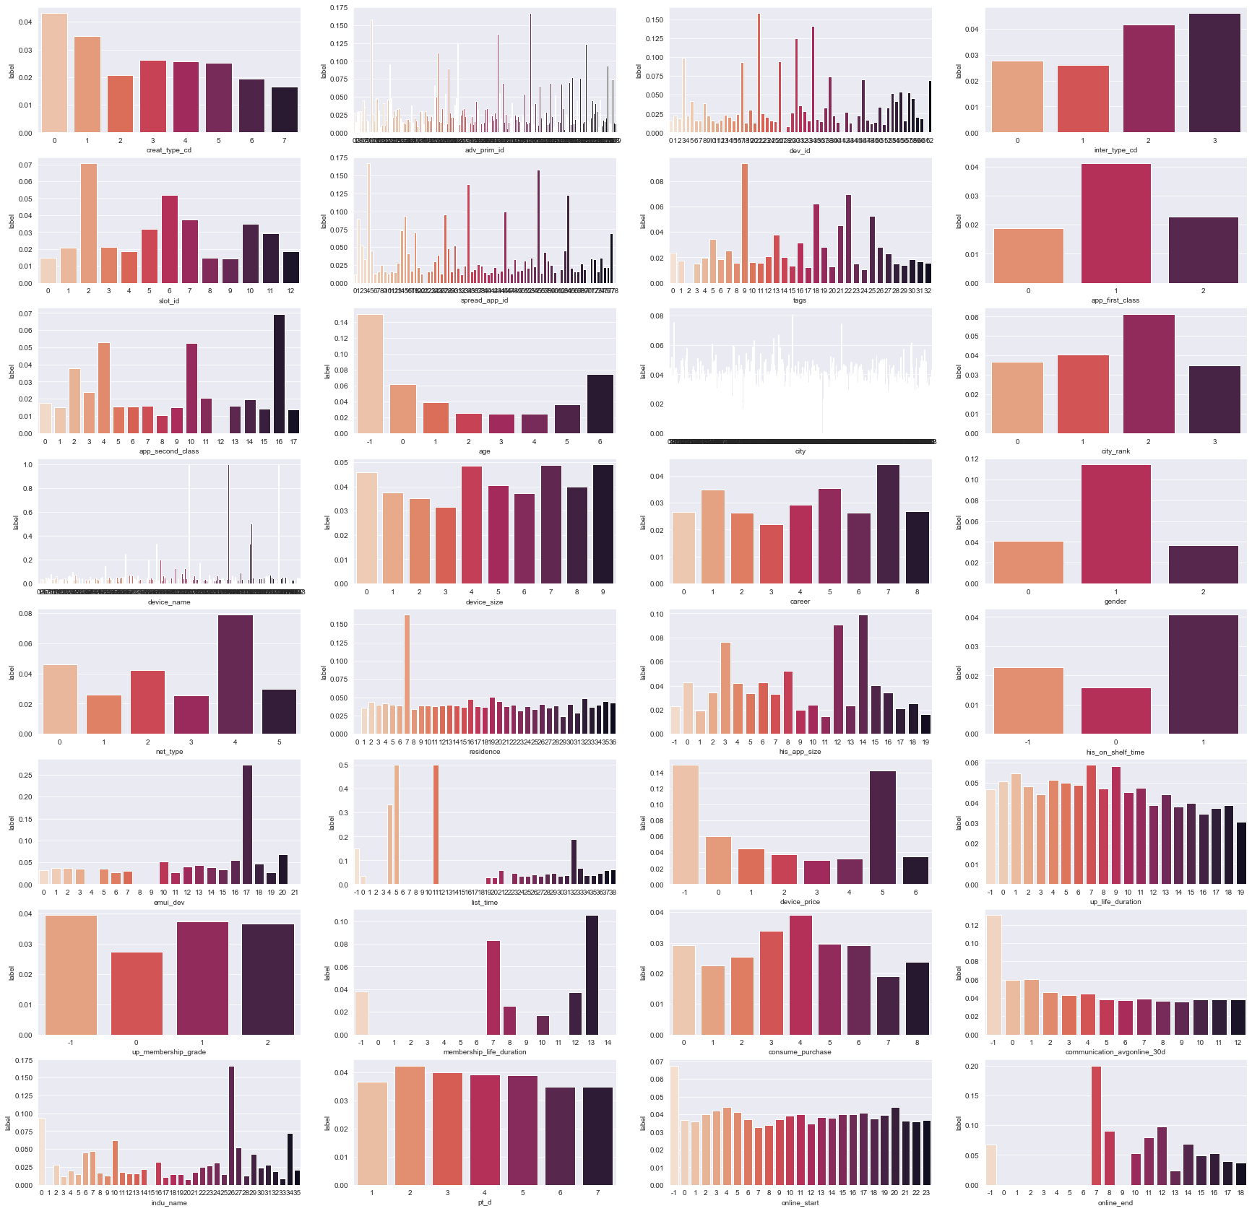
EDA
04
CTR Distribution
05
Correlation Heatmap

Slide 10
Feature Engineering Overview
Data Preprocessing
Feature Engineering
01
01
Missing Value/
Basic Feature Extraction
User Exposure Feature
02
02
Categorical Data Encoder
Cross Effect Feature
35 Features
03
03
Ordinal Data Encoder
CTR Feature
04
04
Memory Reduction
Embedding Feature

Slide 11
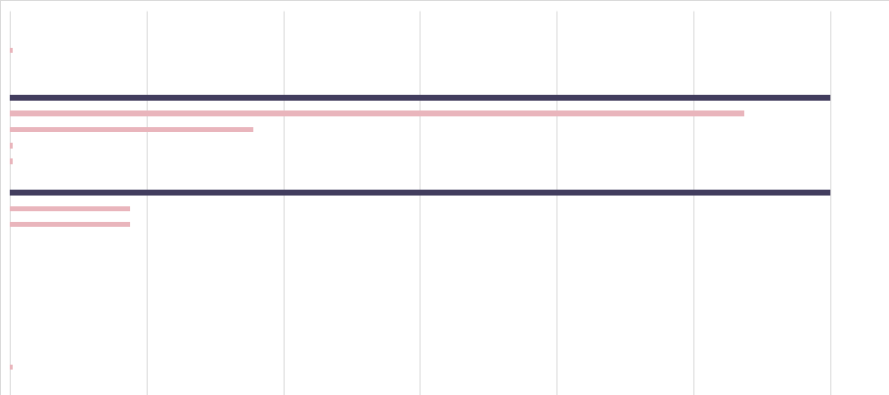




Data Preprocessing
01
02
Missing Value/
Basic Feature Extraction
Nominal Data Encoder
Missing Value
Feature 35
90% Threshold
App Score
City
Gender
Membership Life Duration
Fill with -1
Drop
Feature 1
Advertisement ID
Device ID
Basic Feature Extraction
Online Time: Text
4^5^6^7^8^9^10^11^12^
13^14^15^16^17^18^19^20
Start Time
4
Label Encoder except -1
End Time
20

Slide 12

Data Preprocessing
03
04
Ordinal Data Encoder
Memory Reduction
- Not actually continuous
Data Structure
Int8
[-128 , 127]
Mobile Device Launch Time
Device Price/Size
Int16
[-32768 ,32767 ]
Int32
[-2146483648,...]
Put into Buckets
Equally Spaced
Frequency
Considered
Find appropriate data
type for each feature
→ 80% Memory Reduced

Slide 13
Feature Engineering : Exposure and Interaction
Exposure: Count
Interaction: Crossing Count
Compute the count for each feature value per day ( both train and validation set: Day 1 - Day 7)
Example: User ‘A’ appeared 3 times on Day 1
Apply and create the Count Variables to some features ( User side/Advertisement side/Media(app) side)
Compute the count for each feature pair per day ( both train and validation set: Day 1 - Day 7)
Example: User ‘A’ + Advertisement ‘Apple’ appeared 5 times on Day 1
Apply and create the Crossing features to some pair generated by user profile and advertisement characteristics

Slide 14
Feature Engineering : CTR - Related
CTR
Previous Day CTR
Using the ‘LABEL’ column (mean)
The CTR for train (day 1 - day 6) is computed using its own day’s label mean
The CTR for validation (day 7) is evaluated using the overall label mean of the rest days
Apply and create the CTR features to every features in the data set
Using the ‘LABEL’ column (mean)
Calculate the CTR based on the previous day’s label mean
Set day 6 as the previous day of both day 1 (train) and day 7 (validation)
Apply and create the PREVDAY_CTR features to every features in the data set
Notes:
We also create 2 features using the label column to do more CTR related feature engineering. Because the label column is either 1 or 0, so we calculate the mean to represent the overall CTR ratio, however, the difference is on using different days. The first CTR feature is calculated using their own days, for example, we apply the CTR of day 1 as the CTR feature column for day 1, while for the second features, which is the previous day CTR, rather than the using the current day, we decide to use the previous days’ CTR as values. For example, the previous day ctr column of day 2 is actually using the value of day 1 ctr. Also, considering the weekly pattern, both the day 1 and day 7 are using the day 6’ data. For both the CTR related features, we apply to every columns in the dataset.

Slide 15
Feature Engineering : Embedding
Word2Vec
Convert data into numerical matrix
Use SKIP - GRAM for Word2Vec
Set embedding size = 8
Primarily apply to User & Ads related features cross-relationship with others
Example:
User id & Adv id Adv id & User age
User id & Adv tags Adv id & Adv App id
Adv id & Residence Adv id & City rank
Notes:
Besides, we also do some nlp feature engineering, which we utilize the skipgram for word2vec with embedding size equals to 8. And rather than applying the word2vec to every single columns, we only choose the user related and ads related features to calculate the vectors.

Slide 16
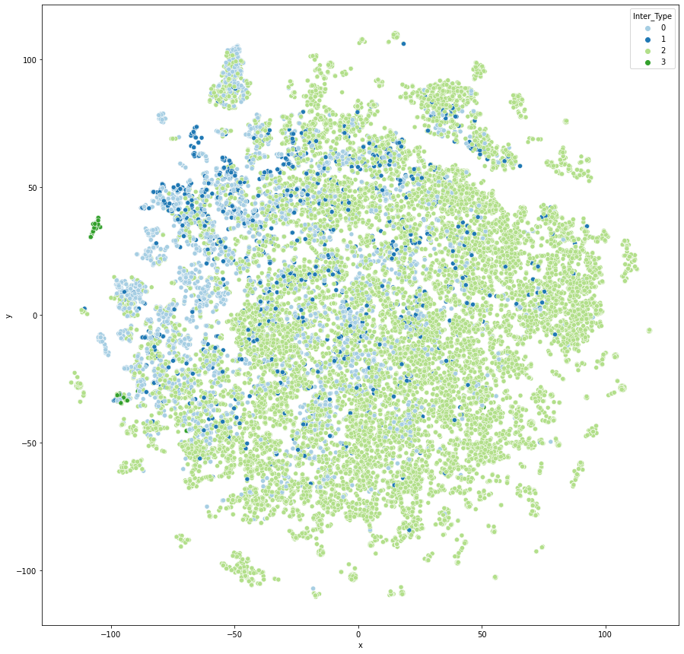
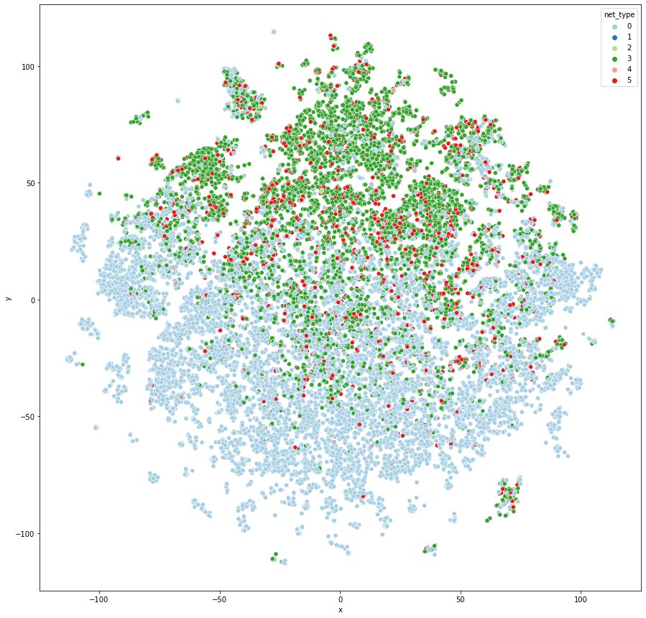
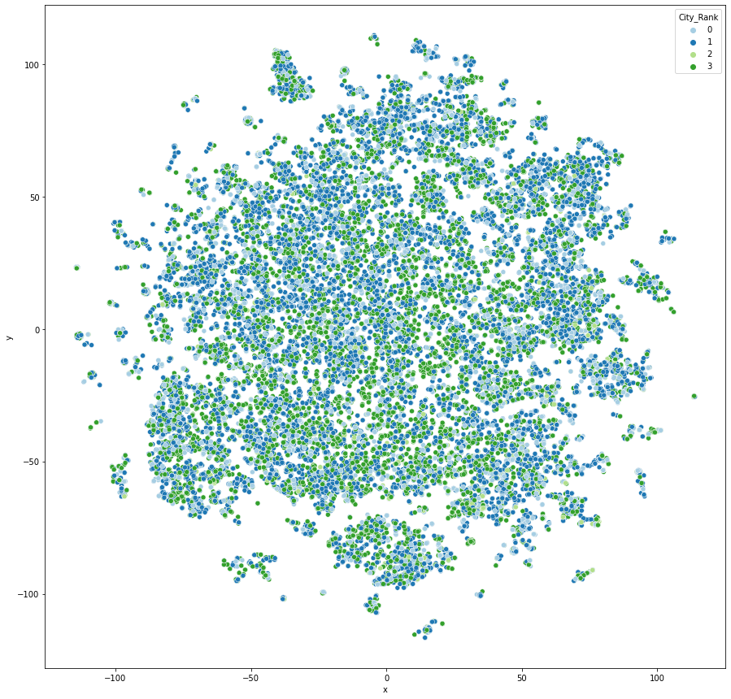
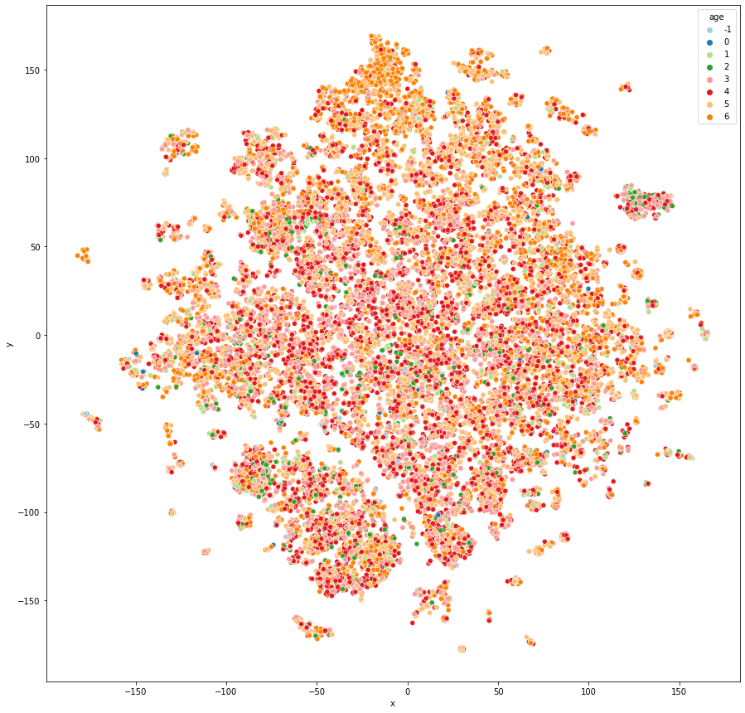
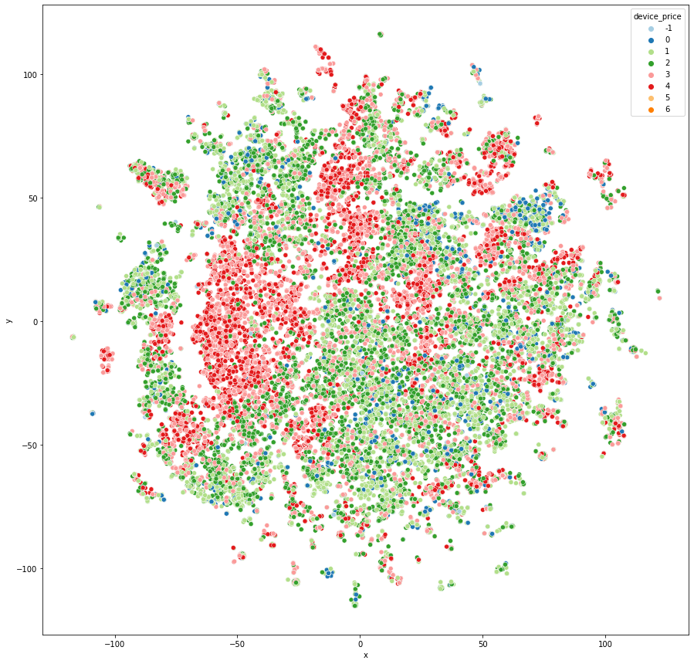
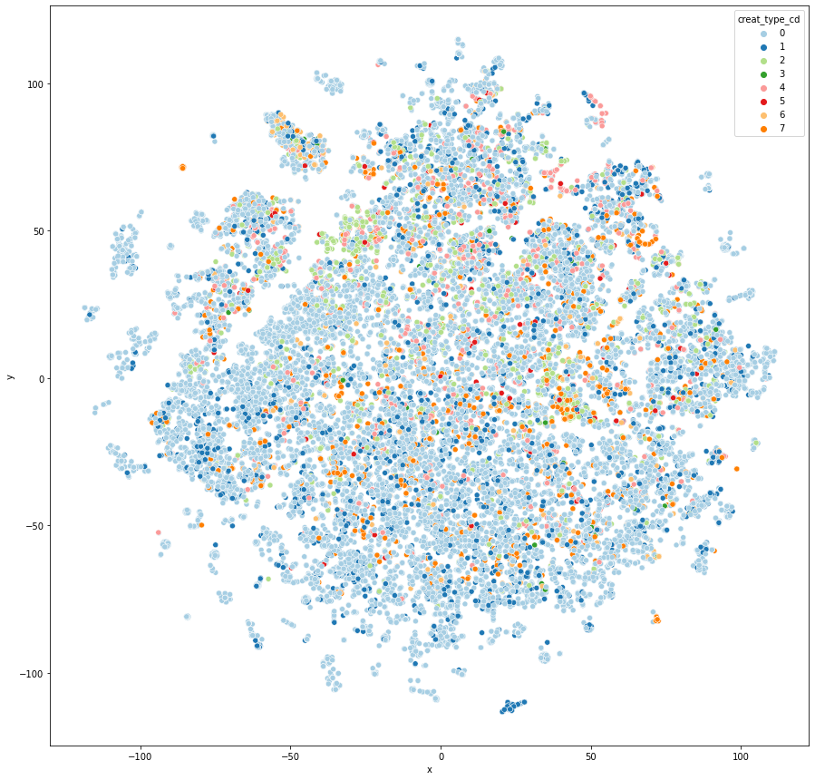
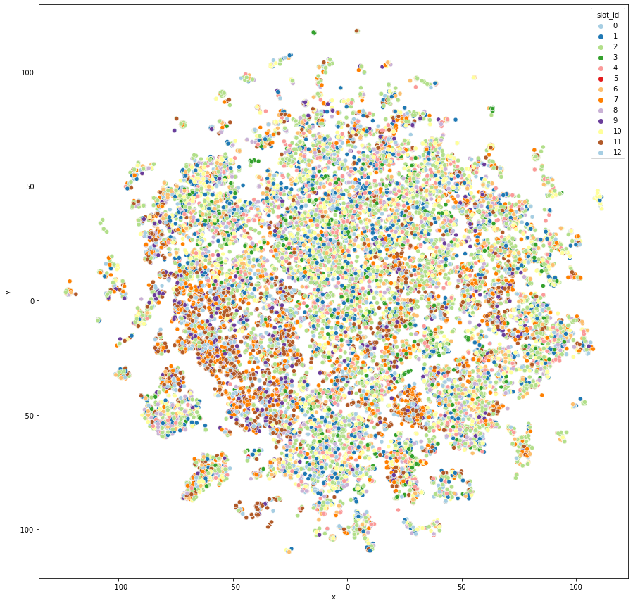
Embedding: T-SNE Visualization
With obvious patterns
Without patterns
inter_type
net_type
city_rank
age
device_price
creat_type
slot_id
Notes:
After we have the word2vec columns, we apply the tsne in order to see if there are clustering patterns among the user and ads relationship. And from the 7 visualizations, we can clearly see that when we cluster by display form of ads, internet status, and device prices, we are more likely to have the clear clustering with patterns, while the city rank, age or slot types do not have obvious clusterings.

Slide 17
03
Model Mining

Slide 18
LightGBM Introduction
LightGBM (Light Gradient Boosting)
Histogram based algorithm
buckets continuous features into discrete bins
Developed by Microsoft in 2016
Distributed Gradient Boosting
Decision Tree Algorithm
Used for classification, ranking, etc.
Improve performance and scalability
Gradient-Based One-Side Sampling (GOSS)
Exclusive Feature Bunding (EFB)
ALWAYS used for CTR prediction problem & high-dimensional data
EFB
Dimension reduction by bundling features together
GOSS
Retains large gradients while random sampling small gradients
Notes:
Because the dataset is a supervised classification problem, we choose the light gbm and random forest as models for our project. Gbm is an assemble gradient boosting method that based on decision tree algorithm, which is used for classification and ranking. We choose this model because this model is largely used in the CTR prediction problem as well as in high-dimensional dataset, which is our case. There are 3 major highlights for this model, which is the histogram based algorithm, and Exlusive feature bunding, and the gradient based one side sampling. Generally, teh EFB is used for reduce dimension by bundling features together while the GOSS is used to improve efficiency by retain only large gradients and sample some small gradients in order to save time
https://towardsdatascience.com/what-makes-lightgbm-lightning-fast-a27cf0d9785e
常被捆绑的特征都是互斥的（即特征不会同时为非零值，像one-hot）

Slide 19
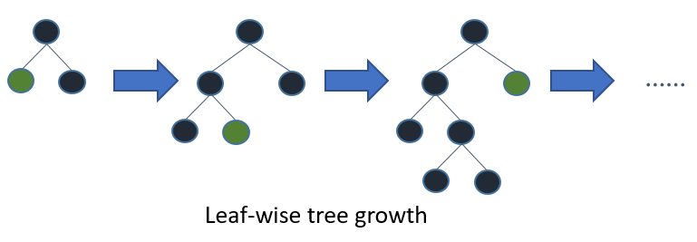
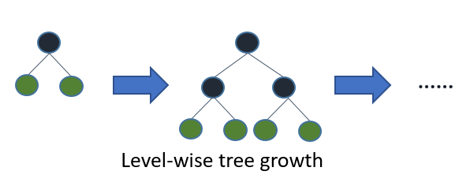
LightGBM & Random Forest
LightGBM
Random Forest
Boosting
01
Bagging
Sample according to error rate
Sample drawn with replacement
Leaf - Wise
02
Level - Wise
Avoid overfitting with smaller computation cost
Good for engineering optimization
Notes:
Here are some major comparison between the gbm and the random forest, as you can see, the lightgbm is leaf wise, which menase the gbm will select those leaf with values to split instead of splitting in the whole level wise regardless the individual leaf values, like the random forest, so the performance and scalability of the lightgbm is largely surpassed the random forest.

Slide 20
04
Model Findings

Slide 21
Model Framework
01
Train Valid split
02
Undersample
Use day 1-6 for training , use day 7 for validation
Sample negative training samples by 50%
Final model
03
Feature selection
04
Model selection
Use LightGBM to compare different features
Use AUC to compare lgbm and random forest

Slide 22
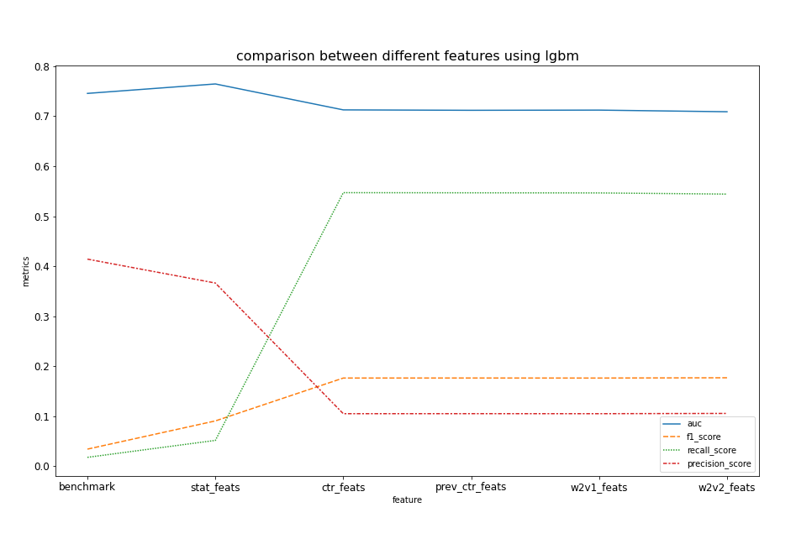
Feature Performance Comparison
LightGBM
Stat features
AUC + 0.02
CTR features
Recall + 0.5
W2V features
AUC increases
We selected original features, stat features, all ctr features and one set of embedding features for final model.

Slide 23
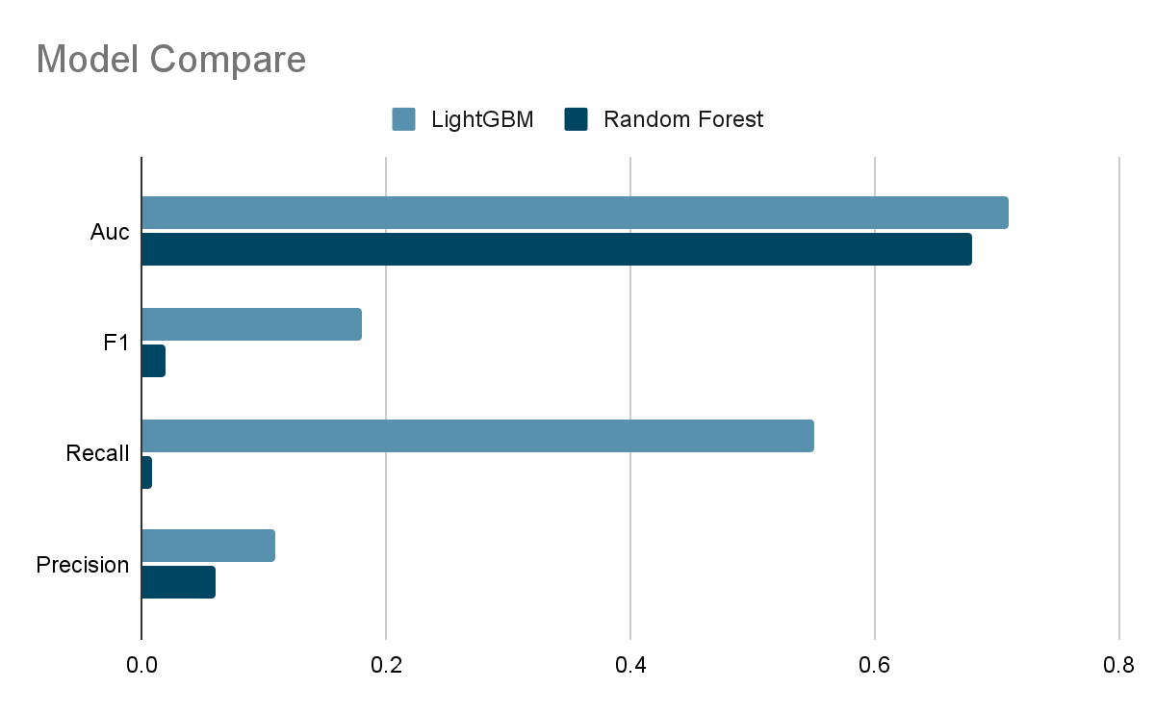
Model Selection
Parameter Tuning
Strategy: Bayesian Optimization
boosting_type | goss | is_unbalanced | True
lambda_l1 | 1.79 | learning_rate | 0.05
max_depth | 11 | lambda_l2 | 4.75
num_leaves | 179 | bagging_fraction | 1.0
colsample_bytree | 0.5 | min_child_sample | 15
Best Model
Choose LightGBM as our final model
AUC | 0.79 | Recall | 0.66
F1 | 0.18 | Precision | 0.11
Notes:
RF:Train 200,000, validation 50,000
Lightgbm: train 1334,825, validation 429932

Slide 24
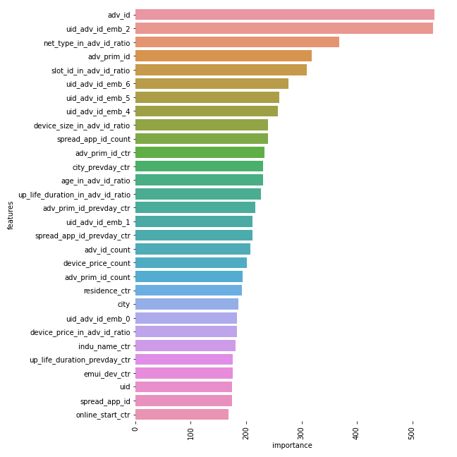
Detailed Feature Importance
01
8 customer related features
Focus on personalized ads, especially users’ age, career, residence, etc;
02
Embedding features
Use ad embedding to represent users are effective features for prediction
03
Slot_id feature
Ad position impacts CTR greatly
04
4 device related features
Device type, price, size and net type impact CTR

Slide 25
05
Conclusion
Future work

Slide 26
Findings & Recommendations
Challenges
slot_id related feature
Deeper analysis on ads position on Apps
device-related features
Have customized ads for different types of mobile devices
Enormous data size - needs high computational power
Masked data - can only conclude on feature importance, but unable to generate literal recommendations
Imbalance issue - 96.1% vs. 3.9%; did perform SMOTE and undersampled the data, but was still unbalanced
Size | 456 MB
Dtype | All numerical Int64 / float64

Slide 27
Future Works
Project Improvements
More delicate parameter tuning
Embedding is an important technique to predict CTR, but did not lift our model’s performance up although deemed as important. We could try more combinations of embedded features and see how they can positively affect our model performance
Could add weight to days when predicting day 7
Future extensions
Geospatial location analysis - city and province names in original dataset are masked. Had we have unmasked geographical information, we could potentially analyze CTR trend within different regions
Time of day analysis - we only know which day each record was on within a 7-day period. Had we have the specific time of day information about when the ads were pushed to users, we could do analysis on CTR patterns throughout different periods of a day

Slide 28
Thank You For Listening!

